Slide 2
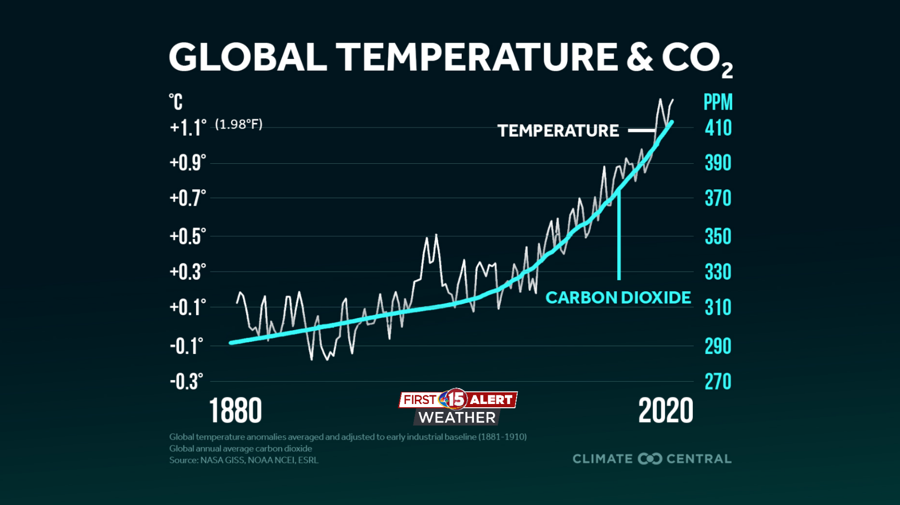
What are climate-friendly plants?
Carbon dioxide concentration in 2021 = 419 ppm
Deforestation, industry, increased burning of fossil fuels, agriculture, rapid urbanization…
High level of CO₂ affect whole biosphere
Increase of temperature, degraded and disappearing ecosystem, extreme weather, acidification of the oceans etc.

Slide 3
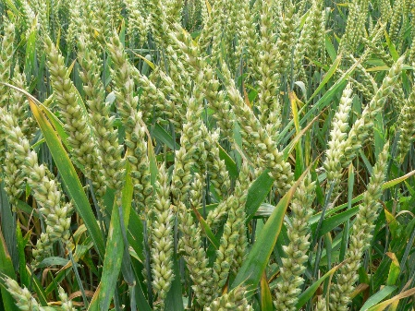
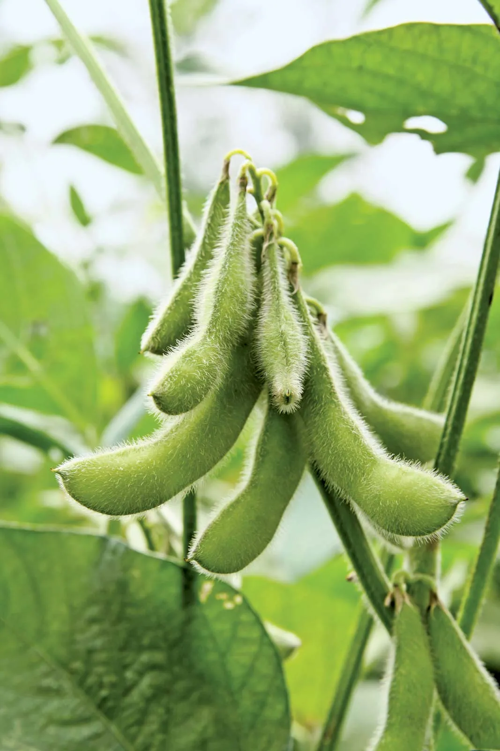
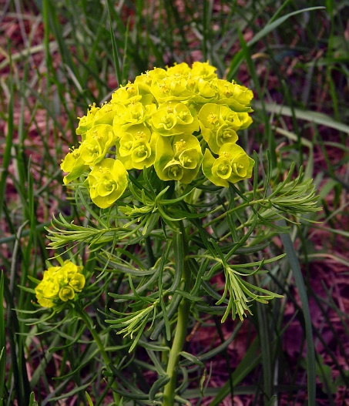
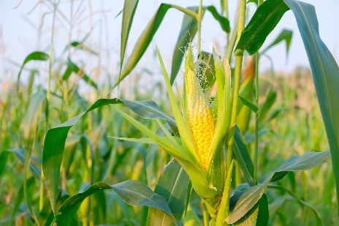
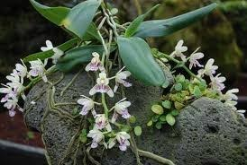
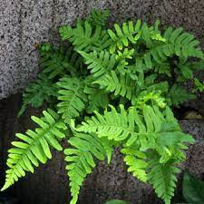
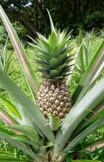
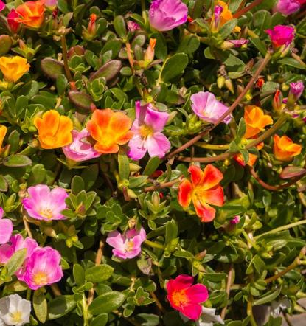
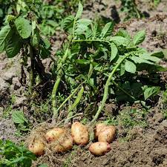
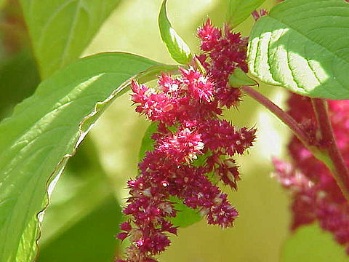
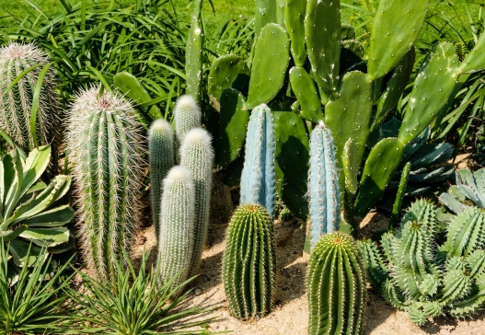
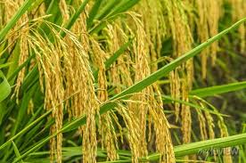
Why do we need climate-friendly plants?
C3 plants
C4 plants
CAM plants

Slide 4
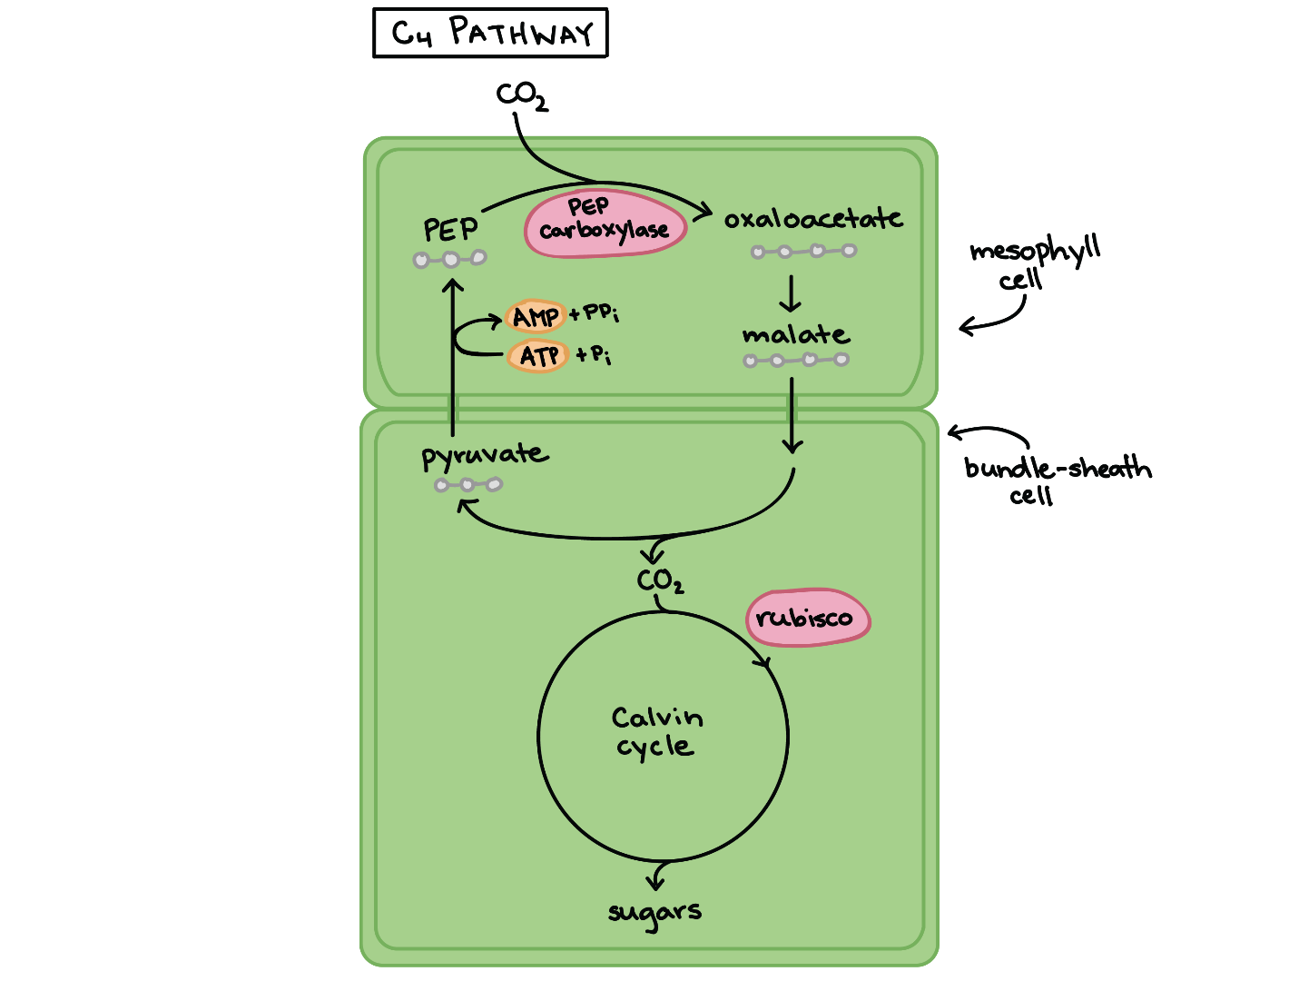
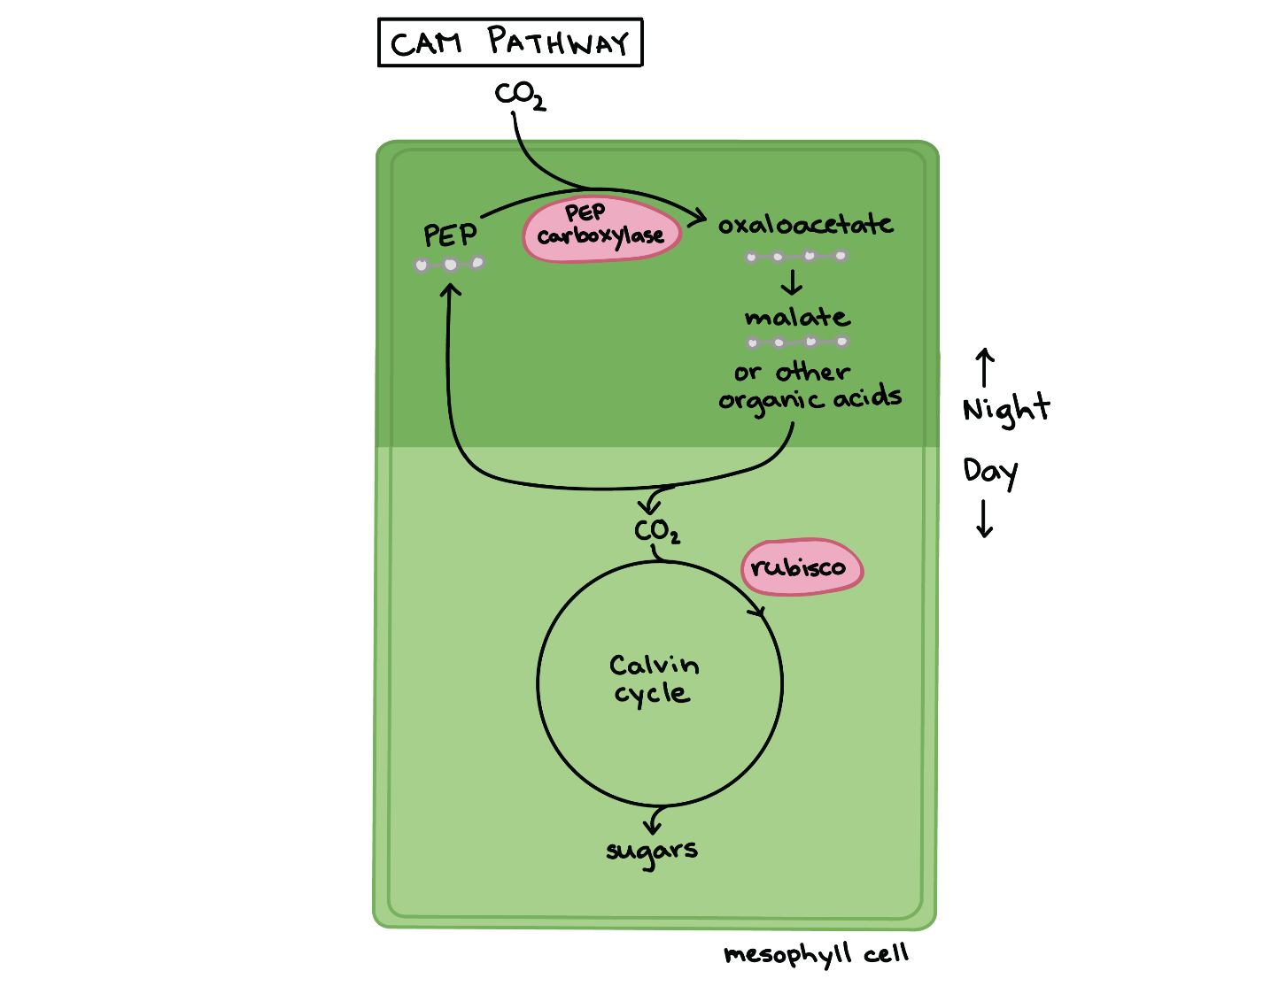
Why do we need climate-friendly plants?
C3 plants
C4 plants
CAM plants
Khan Academy. Accessed 28.4.2022. https://www.khanacademy.org.

Slide 5
Photorespiration
Enzym rubisco – the most abundant enzyme on the Earth
Rubisco binds with O₂ instead of CO₂
Only in C3 plants, during hot and dry days
Drains the Calvin cycle = ↓ photosynthetic output, no energy (ATP) is produced, no „food molecules“ (G3P) are produced
Wasteful process with NO benefits, it even limits the growth rate of plants
-energy
Ribulose 1,5-BP
O₂
CO₂
Photorespiration
Ribulose 1,5-BP
Calvin Cycle
3PGlycerate
Ribulose-5P
CO2 and ammonia
Rubisco
Serine
Triose Phosphate
Glycine
2-PGlycolate
3PGlycerate
3PGlycerate (food)

Slide 6
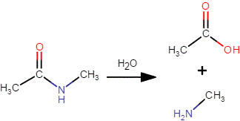
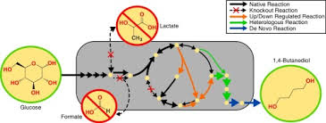
Solution: synthetic biology
Step 1:
Designing theoretical reactions in silico
Biological systems
Self-optimizing
Self-repairing
Self-propagating
Sustainable
Environmental friendly
Output: Finding/engineering enzymes
Step 2:
Building and optimizing the pathway
Output: Synthetic pathway
Step 3:
Introducing of the synthetic pathway in living cells

Slide 7
1. Identification of enzymes
Which enzymes are suitable? Measuring of efficiency of enzymes
k_{cat}= Turnover number (s⁻¹)
Chemical conversion of substrate,
molecules per second per active site
K_{m}= Michaelis constant(M⁻¹)
Substrate concentration at half maximum activity
Catalytic efficiency
k_{cat} / K_{m}
Notes:
Synthetic
The first problem is to identify the enzymes, We are looking the enzymes with high Kcat number, so it means they can convert the substrate molecule at a high speed, however with a lot Michaelis constant Km, which is telling us that the enzyme can operate at very low substrate concentration. So in the end, we have to choose the enzymes which are operating at high turnover rate but at very low substrate concentration. Why, it is because in the atmosfere we have only very low concentration of CO2, only about 0.04%. So the fist step is to go through the biological databases and and to identify the catalytical efficiency of various enzymes. For example, the ERS, or enoyl-CoA carboxylase/reductase is up to 4x more efficient than rubisco. So this is the first enzyme, however, it after fixation it will lead to producing of product which is not known for a plant, so it means you need to find several other enzymes which are using the product of previous reaction as a substrate for the new reaction.
.

Slide 8
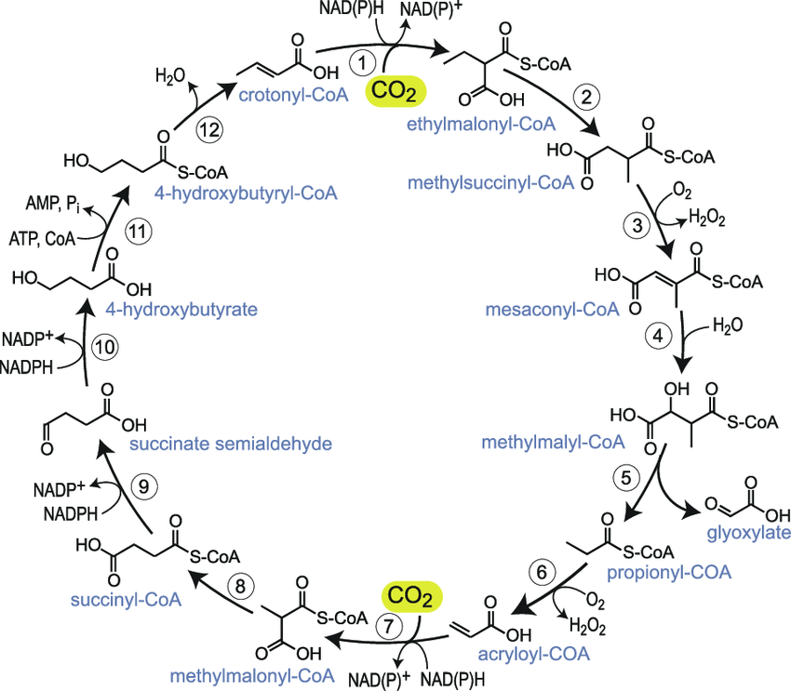
2. Building and optimizing the pathway
peroxisome
CETCH cycles
17 different enzymes from 9 organisms
13 reactions that increased the rate of CO₂ up to 5-times more efficiently than Calvin cycle
Less energy consumption
DRAWBACK: acetyl-CoA must be added
Alternative photorespiration 3
Glycolate deghydrogenase (Chlamydomonas reinhardtii) and malate synthase (Cucurbita maxima)
Blocking of plastidic glycolate/glycerate transporter 1 (PLGG1) – reducing oxygenase activity of rubisco
PLGG1
CETCH cycle
glycolate
glyoxylate
Acetyl-CoA
malate
CO₂
pyruvate
CO₂
Notes:
There is several works trying to optimizing photosynthesis and to reduce photorespiration. We optimize and linked two different synthetic pathways – CETCH cycle which use 17 different enzymes form 9 organism, and is five times more efficient than photosynthetic pathway of C3 plants, and alternative photorespiration 3 foun South, which consist of two aditional enzymes, one from bacteria and one from cucumer, and also is blocking the receptor PLGG1, which is important for the uptake of oxygen by rubisco instead of CO2.

Slide 9
2. Building and optimizing the pathway
Model 1: Native
Model 2: AP3
Model 3: CETCH + AP3
RuBP
O₂
CO₂
RuBP
RuBP
O₂
CO₂
RuBP
RuBP
O₂
CO₂
C CoA
pyruvate
pyruvate
rubisco
PGA
Acetyl-CoA
rubisco
Acetyl-CoA
rubisco
CETCH
PGA
malate
PGA
malate
MCoA
glyoxalate
2P-glycolate
glyoxalate
2P-glycolate
ECoA
CO₂
PG+PGA
2x 3PGA
glycolate
2x 3PGA
glycolate
ACoA
PLGG1
sugars
PLGG1
sugars
PLGG1
sugars
photorespiration
photorespiration
Naseem et al. 2020

Slide 10
Optimized model
Only AP3 model: bad connection and low regeneration rate observed
Only CETCH model: substrate competition, problematic regeneration of NADPH
AP3+CETCH + blocking of PLGG1
Repressed enzyme activities of photorespiratory pathway
Reduction of oxygenase activity of rubisco
Drastically reduced flux of metabolites into the peroxisomes
Glycolate is produced, but it is converted into malate in chloroplast which could be used for the another CO₂ convertion
75% higher enzyme activity

Slide 11
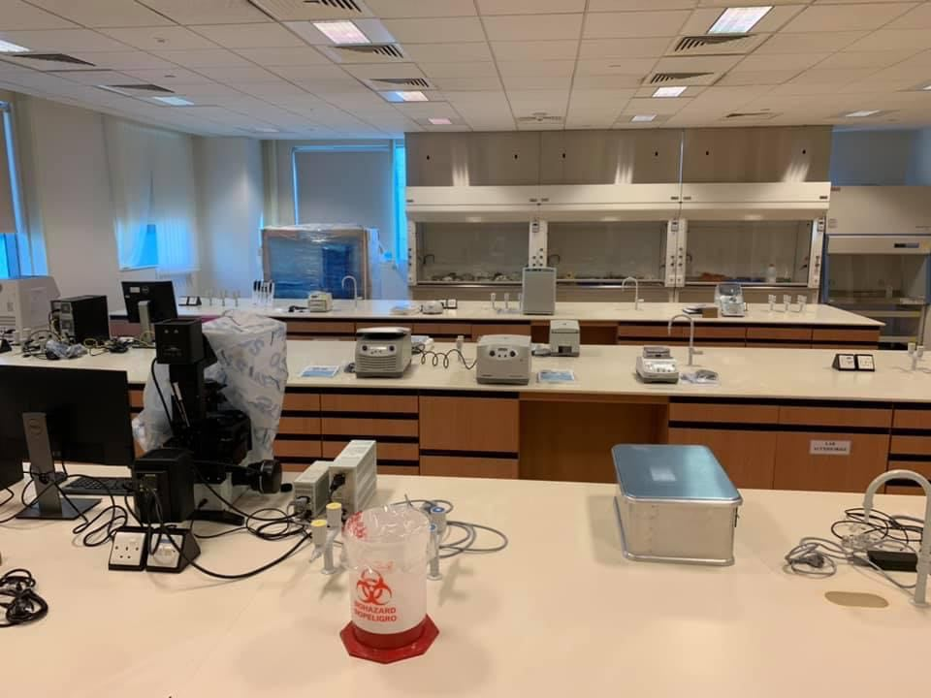
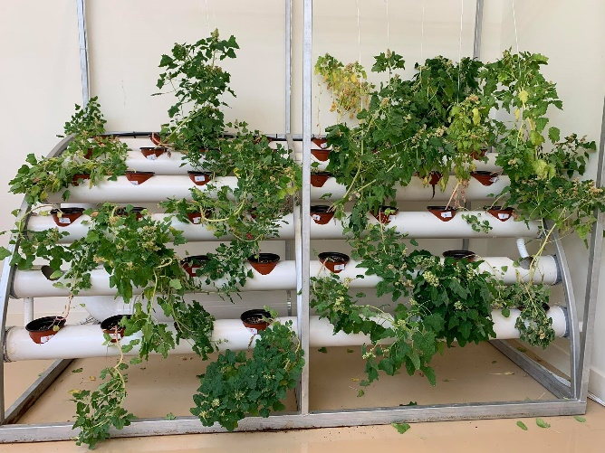
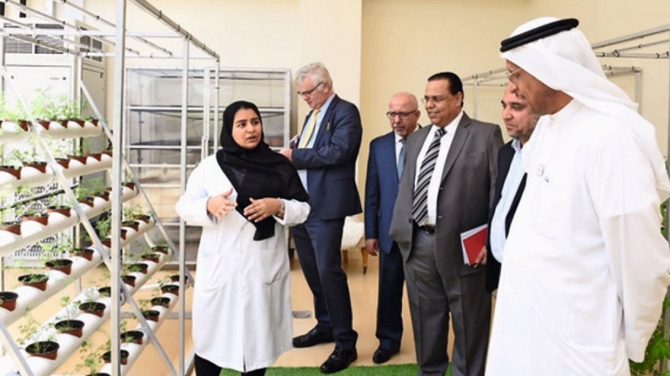
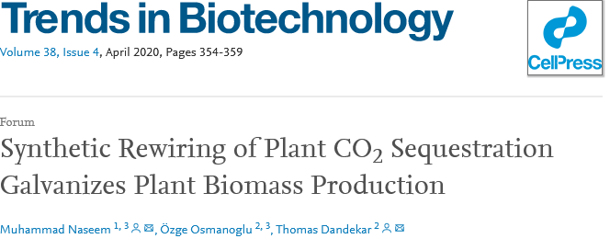
Next step: introduction into plants
Cloning strategy
Preparation of 19 enzymes
Gibson assembly
Subcloning to the plant vector
Transformation of Agrobacterium tumefaciens
Floral dip method
Growing of the seedlings and selection of vector-bearing plants
Assessment of carbon dioxide uptake

Slide 12
Thank you for your attention

